Slide 1
CHAPTER 16
ENABLE FEEDBACK SO DEPLOYMENT AND OPERATIONS CAN SAFELY DEPLOY CODE
PRESENTED BY THEOPHILUS NWEA-MIAH

Slide 2
INTRODUCTION
BEFORE WE CAN ENABLE FEEDBACK SO THAT DEPLOYMENT AND OPERATION CAN SAFELY DEPLOY CODE, WE NEED TO
USE TELEMETRY TO MAKE DEPLOYMENT SAFER
Have Dev Share Pager Rotation Duties With Ops
Have Developers Follow Work Downstream
Have Developers Initially Self-Manage Their Production Service

Slide 3
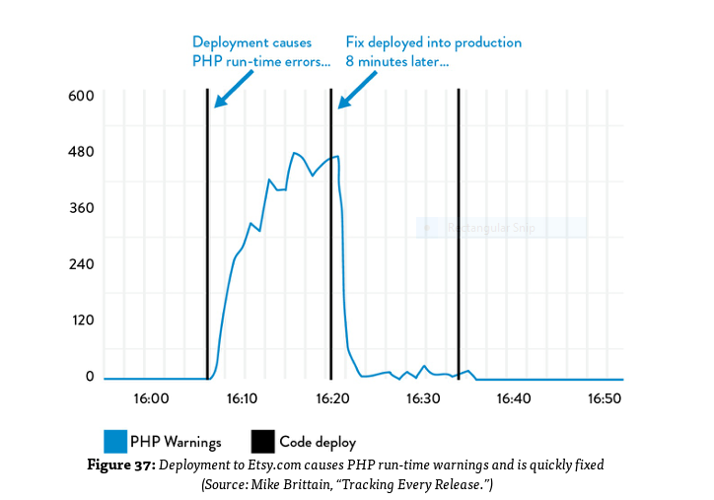
USE TELEMETRY TO MAKE DEPLOYMENT SAFER
Monitor production telemetry and perform production deployment.
Monitor metric associated with our future during our deployment.
Automate testing and fast deployment process.
Catch errors in our deployment pipeline before the get into production ,

Slide 4
Have Dev Share Pager Rotation Duties With Ops
Shares the downstream responsibilities of handling operational incidents.
Put developers, development managers, and architects on pager rotation so that everyone in the value stream shares the downstream responsibilities of handling operational incidents.
Ensure everyone in the value stream get visual feedback on any upstream architectural and coding decision that they make.

Slide 5
Have Developers Follow Work Downstream
Check customer difficulties firsthand.
Create feedback on non-functional aspect of our code.
Create UX application to enable the creation of quality source and result in the value stream.
Create codified non-functional requirements in our shared backlog of work.
Create DevOps work culture.

Slide 6
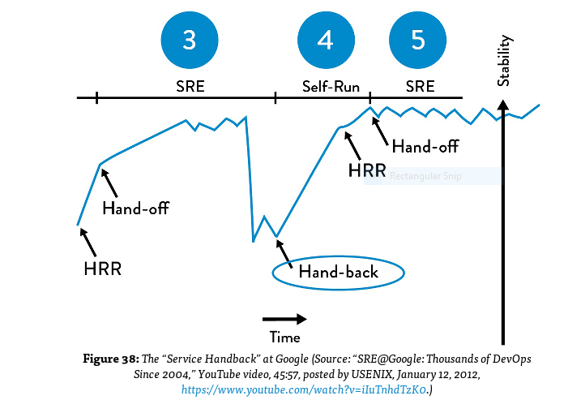
Have Developers Initially Self-Manage Their Production Service
Create lunch guidance to help teams to benefit form cumulative and collective experience in organization base on these requirements
Defect count and severity.
Type/frequency of paper alert.
Monitoring coverage.
System architecture.
Deployment process.

Slide 7
CONCLUTION
Creating non-functional requirements help deployment team to write more production-ready code .
Enabling feedback mechanisms help us to improve our service at every stage of our daily work.
Creating feedback loops help us to increase the production readiness of our code created by development and also help make production deployment safer.
Feedback loops help create better relationship between development and operation

